Slide 1

CS61B
Lecture 27: Graphs II: Traversals
DepthFirstPaths Implementation
General Graph Traversals
Topological Sorting
Breadth First Search
Notes:
First hit for random on google images: http://imalbum.aufeminin.com/album/D20090918/595987_CDFNNMFIKOXZB2ECNEHVLRX4BSJB4I_chester-2020_H204533_L.jpg

Slide 2
Depth First Paths

Slide 3

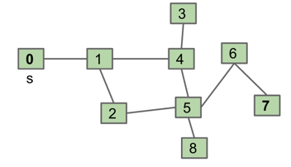
Depth First Search Implementation
Common design pattern in graph algorithms: Decouple type from processing algorithm.
Create a graph object.
Pass the graph to a graph-processing method (or constructor) in a client class.
Query the client class for information.
public class Paths {
public Paths(Graph G, int s): Find all paths from G
boolean hasPathTo(int v): is there a path from s to v?
Iterable<Integer> pathTo(int v): path from s to v (if any)
}
Paths.java

Slide 4
Example Usage
Start by calling: Paths P = new Paths(G, 0);
P.hasPathTo(3); //returns true
P.pathTo(3); //returns {0, 1, 4, 3}
Paths.java
public class Paths {
public Paths(Graph G, int s): Find all paths from G
boolean hasPathTo(int v): is there a path from s to v?
Iterable<Integer> pathTo(int v): path from s to v (if any)
}

Slide 5
Implementing Paths With Depth First Search
To visit a vertex v:
Mark vertex v.
Recursively visit all unmarked vertices adjacent to v.
Data Structures:
boolean[] marked
int[] edgeTo
edgeTo[4] = 1, means we went from 1 to 4.
Paths.java
public class Paths {
public Paths(Graph G, int s): Find all paths from G
boolean hasPathTo(int v): is there a path from s to v?
Iterable<Integer> pathTo(int v): path from s to v (if any)
}
Notes:
Ended here.

Slide 6
DepthFirstPaths and Depth First Search
Demo: DepthFirstPaths

Slide 7
DepthFirstPaths and Depth First Search
Demo: DepthFirstPaths
“Depth First Search” is a more general term for any graph search algorithm that traverses a graph as deep as possible before backtracking.
The term is used for several slightly different algorithms. For example:
DFS may refer to the version from the previous lecture that doesn’t use any marks (and thus can get caught in a loop).
DFS may refer to the version where vertices are marked.
DFS may refer to a version where vertices are marked and source edges recorded (as in Depth First Paths).
DFS may refer to other algorithms like the “topological sort algorithm” well discuss later in lecture.
And more!

Slide 8
DepthFirstPaths, Recursive Implementation
public class DepthFirstPaths {
private boolean[] marked;
private int[] edgeTo;
private int s;
public DepthFirstPaths(Graph G, int s) {
...
dfs(G, s);
}
private void dfs(Graph G, int v) {
marked[v] = true;
for (int w : G.adj(v)) {
if (!marked[w]) {
edgeTo[w] = v;
dfs(G, w);
}
}
}
}
marked[v] is true iff v connected to s
edgeTo[v] is previous vertex on path from s to v
not shown: data structure initialization
find vertices connected to s.
recursive routine does the work and stores results in an easy to query manner!
Question: How would we write hasPathTo(v)?

Slide 9
Graph Problems
Problem | Problem Description | Solution | Efficiency
s-t paths | Find a path from s to every reachable vertex. | DepthFirstPaths.java Demo | Θ(V+E) time Θ(V) space
Runtime is Θ(V+E)
Each vertex is visited once and each edge is used exactly once. Each visit costs constant time.
Space is Θ(V).
Call stack depth is at most V.

Slide 10
Graph Traversals

Slide 11
Graph Traversals (warm up for rest of lecture)
Just as there are many tree traversals:
Preorder: DBACFEG
Inorder: ABCDEFG
Postorder: ACBEGFD
Level order: DBFACEG
D
B
F
A
C
E
G
So too are there many graph traversals, given some source:
DFS Preorder, order of DFS calls
012543678
DFS Postorder, order of returns from DFS
347685210
Level-order: Order of increasing distance from s.
0 1 24 53 68 7
3
0
1
4
6
s
2
5
7
8

Slide 12
Level Order Traversals: http://yellkey.com/become
2
Warning: Level order is a non-standard term for graphs. The usual phrasing (as we’ll learn later) is “the order visited by breadth first search”.
0
3
5
1
4
6
7
Which of the following is not a valid level order traversal from vertex 2?
2 3 5 4 6 7
2 3 4 7 5 6
2 5 3 6 4 7
2 3 5 6 4 7

Slide 13
Level Order Traversals: http://yellkey.com/become
2
Warning: Level order is a non-standard term for graphs. The usual phrasing (as we’ll learn later) is “the order visited by breadth first search”.
0
3
5
1
4
6
7
Which of the following is not a valid level order traversal from vertex 2?
2 3 5 4 6 7
2 3 4 7 5 6
2 5 3 6 4 7
2 3 5 6 4 7

Slide 14
Level Order Traversals: http://yellkey.com/fine
2
Warning: Level order is a non-standard term for graphs. The usual phrasing (as we’ll learn later) is “the order visited by breadth first search”.
0
3
5
1
4
6
7
This time, which are valid level order traversals from vertex 2?
2 3 5 4 6 7
2 3 4 7 5 6
2 5 3 6 4 7
2 3 5 6 4 7
Notes:
Alex Made this (Yay)

Slide 15
Level Order Traversals: http://yellkey.com/fine
2
Warning: Level order is a non-standard term for graphs. The usual phrasing (as we’ll learn later) is “the order visited by breadth first search”.
0
3
5
1
4
6
7
This time, which are valid level order traversals from vertex 2?
2 3 5 4 6 7
2 3 4 7 5 6
2 5 3 6 4 7
2 3 5 6 4 7
Notes:
Alex Made this (Yay)

Slide 16
DFS Postorder: http://yellkey.com/help
2
0:
1:
2: 3:
4:
[1, 3]
0
3
5
1
4
6
7
What is the DFS postorder of this graph starting at 0? Assume items appear in adjacency lists in increasing order. DFS postorder is the order of returns from DFS.
0 1 3 4 7
7 4 3 1 0
7 4 1 0 3
7 4 1 3 0
0 1 4 7 3

Slide 17
DFS Postorder: http://yellkey.com/help
2
0:
1:
2: 3:
4:
[1, 3]
0
3
5
1
4
6
7
What is the DFS postorder of this graph starting at 0? Assume items appear in adjacency lists in increasing order. DFS postorder is the order of returns from DFS.
0 1 3 4 7
7 4 3 1 0
7 4 1 0 3
7 4 1 3 0
0 1 4 7 3

Slide 18
DFS Postorder: http://yellkey.com/help
2
0:
1:
2: 3:
4:
[1, 3]
0
3
5
1
4
6
7
What is the DFS postorder of this graph starting at 0? Assume items appear in adjacency lists in increasing order. DFS postorder is the order of returns from DFS.
0 1 3 4 7
7 4 3 1 0
7 4 1 0 3
7 4 1 3 0
0 1 4 7 3

Slide 19
Topological Sorting

Slide 20
Topological Sort
2
0
3
5
1
4
6
7
Suppose we have tasks 0 through 7, where an arrow from v to w indicates that v must happen before w.
What algorithm do we use to find a valid ordering for these tasks?
Valid orderings include: [0, 2, 1, 3, 5, 4, 7, 6], [2, 0, 3, 5, 1, 4, 6, 7], …
Any suggestions on where we’d start?

Slide 21
Solution (Spoiler Alert)
2
0
3
5
1
4
6
7
Perform a DFS traversal from every vertex with indegree 0, NOT clearing markings in between traversals.
Record DFS post order in a list.
Topological ordering is given by the reverse of that list (reverse postorder).

Slide 22
Topological Sort (Demo 1/2)
2
2
2
2
*
0
3
5
0
3
5
0
3
5
0
3
5
*
*
1
4
6
1
4
6
1
4
6
1
4
6
*
7
7
7
7
Postorder: []
Postorder: []
Postorder: []
Postorder: [7]
2
2
2
2
*
*
0
3
5
0
3
5
0
3
5
0
3
5
*
*
1
4
6
4
6
4
6
1
4
6
1
1
7
7
7
7
Postorder: [7, 4]
Postorder: [7, 4, 1]
Postorder: [7, 4, 1]
Postorder: [7, 4, 1, 3]

Slide 23
Topological Sort (Demo 2/2)
2
2
*
2
2
*
*
*
0
3
5
0
3
5
0
3
5
0
3
5
4
6
4
6
4
6
1
4
6
1
1
1
7
7
7
7
Postorder: [7, 4, 1, 3]
Postorder: [7, 4, 1, 3, 0]
Postorder: [7, 4, 1, 3, 0]
Postorder: [7, 4, 1, 3, 0]
2
2
2
*
0
3
5
0
3
5
*
0
3
5
4
6
*
1
4
6
4
6
1
1
7
7
7
Postorder: [7, 4, 1, 3, 0, 6]
Postorder: [7, 4, 1, 3, 0, 6, 5]
Postorder: [7, 4, 1, 3, 0, 6, 5, 2]

Slide 24
Solution (Spoiler Alert)
2
0
3
5
1
4
6
7
Perform a DFS traversal from every vertex with indegree 0, NOT clearing markings in between traversals.
Record DFS post order in a list: [7, 4, 1, 3, 0, 6, 5, 2]
Topological ordering is given by the reverse of that list (reverse postorder):
[2, 5, 6, 0, 3, 1, 4, 7]

Slide 25
Topological Sort
2
0
3
5
2
5
6
0
3
1
4
7
1
4
6
7
The reason it’s called topological sort: Can think of this process as sorting our nodes so they appear in an order consistent with edges, e.g. [2, 5, 6, 0, 3, 1, 4, 7]
When nodes are sorted in diagram, arrows all point rightwards.

Slide 26
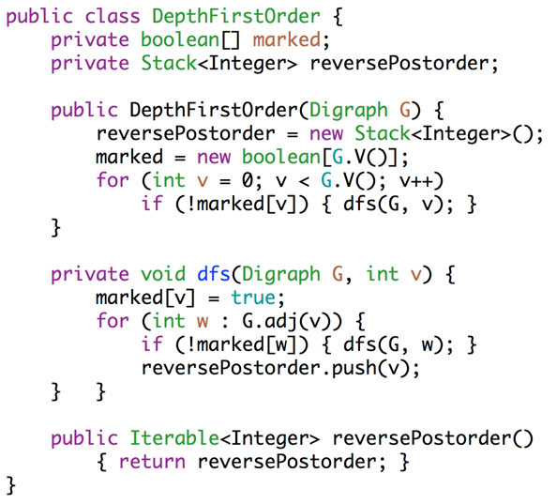
Topological Sort Implementation
public class DepthFirstOrder {
private boolean[] marked;
private Stack<Integer> reversePostorder;
public DepthFirstOrder(Digraph G) {
reversePostorder = new Stack<Integer>();
marked = new boolean[G.V()];
for (int v = 0; v < G.V(); v++) {
if (!marked[v]) { dfs(G, v); }
}
private void dfs(Digraph G, int v) {
marked[v] = true;
for (int w : G.adj(v)) {
if (!marked[w]) { dfs(G, w); }
}
reversePostorder.push(v);
}
public Iterable<Integer> reversePostorder()
{ return reversePostorder; }
}
Textbook implementation (shown here) uses a stack instead of a creating a list and then reversing it.
Create empty stack.
Perform DFS of all unmarked vertices.
Note: Our algorithm earlier started at vertices with indegree zero. It turns out this algorithm works no matter where you start!
After each DFS is done, ‘visit’ vertex by putting on a stack.

Slide 27
Graph Problems
Problem | Problem Description | Solution | Efficiency
s-t paths | Find a path from s to every reachable vertex. | DepthFirstPaths.java Demo | Θ(V+E) time Θ(V) space
topological sort | Find an ordering of vertices consistent with directed edges. | DepthFirstOrder.java Demo | Θ(V+E) time Θ(V) space

Slide 28
Breadth First Search

Slide 29
Breadth First Search
2
0
3
5
1
4
6
7
Goal: Given the graph above, find the shortest path from 0 to every other vertex.
Level-order provides the shortest paths from 0 to every reachable vertex from 0 (by definition!)

Slide 30
Finding the “Level-Order”
For trees (a special type of graph), we used iterative deepening.
Bad for spindly trees, Θ(N²).
Breadth First Search.
Initialize a queue with a starting vertex s and mark that vertex.
Let’s call this the fringe.
Repeat until queue is empty:
Remove vertex v from queue.
Add to the queue any unmarked vertices adjacent to v and mark them.
BreadthFirstPaths demo.
From here on out, we’ll refer to “level order” as “the order visited by BFS”.

Slide 31
BreadthFirstPaths Implementation
public class BreadthFirstPaths {
private boolean[] marked;
private int[] edgeTo;
...
private void bfs(Graph G, int s) {
Queue<Integer> fringe =
new Queue<Integer>();
fringe.enqueue(s);
marked[s] = true;
while (!fringe.isEmpty()) {
int v = fringe.dequeue();
for (int w : G.adj(v)) {
if (!marked[w]) {
fringe.enqueue(w);
marked[w] = true;
edgeTo[w] = v;
}
}
}
}
marked[v] is true iff v connected to s
edgeTo[v] is previous vertex on path from s to v
set up starting vertex
for freshly dequeued vertex v, for each neighbor that is unmarked:
Enqueue that neighbor to the fringe.
Mark it.
Set its edgeTo to v.

Slide 32
Breadth First Search
Our code for BFS examines vertices in increasing order from source.
Why? The fringe queue always consists of the following (for some k):
≥ 0 vertices of distance k from s,
≥ 0 vertices of distance k + 1 from s
Handy for finding shortest paths.
Runs in V+E time and uses V space:
Each vertex and each edge processed a constant number of times.
No vertex may be enqueued more than once.

Slide 33
BreadthFirstSearch for Google Maps
Would breadth first search be a good algorithm for a navigation tool (e.g. Google Maps)?
Assume vertices are intersection and edges are roads connecting intersections.
Some roads are longer than others.
BAD!

Slide 34
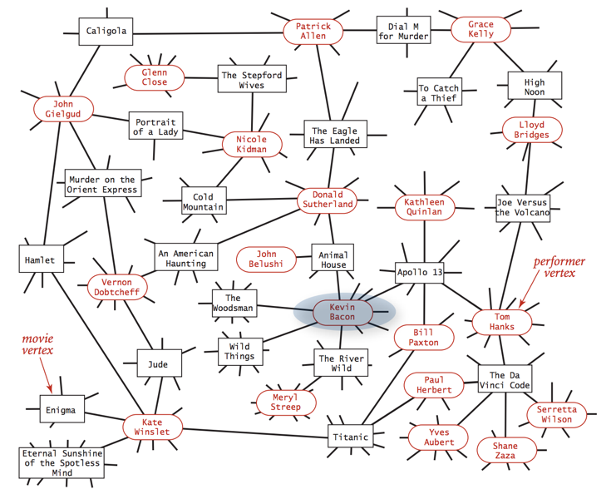
One use of BFS: Kevin Bacon
Graph with two types of vertices:
Movies
Actors
Perform BFS from s=Kevin Bacon.

Slide 35
Citations
http://www.gosidemount.com/Guided_Diving/images/guided_cavern.jpg

